Slide 1
Phrase prediction algorithm for Auto-completion

Slide 2

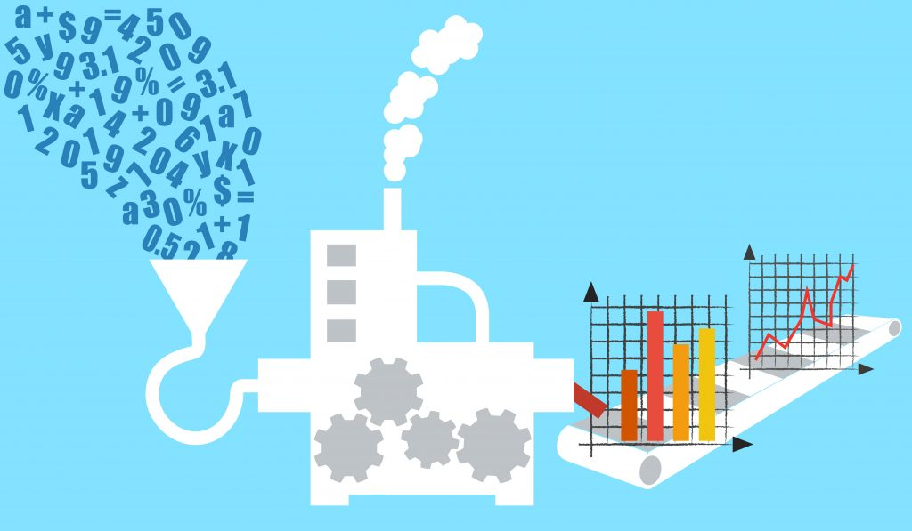

Part 1
Part 2
Part 3
Part 4
Data Preprocessing
Training model
Output generation

Slide 3
Part 1
Preprocessing phase
Reading all .xml files.
Collecting catchphrase and sentences in dataframes
Combining text from catchphrase and sentences
Save data to an intermediate text file

Slide 4
Part 2
Preprocessing phase 2
Reading output of part 1 into variable
Removing unnecessary characters from the lines.
Tokenizing data
Create each line of 5 words by left shifting of words
Writing all the generated lines to a text file as output from part 2

Slide 5
Part 3
Model creation and training
Load text file generated from part 2
Tokenization of all the words which assign an id to words.
Creation of training and testing data from dataset
RNN using sequential model is created with LSTM and dense layers.
Training model using our training data
Plotting graph for accuracy and errors wrt epochs
Save the trained model.

Slide 6
Part 4
Output generation
Loading of model generated from part 3.
Data creation for testing purpose
Passing of data to model and generation of output.
Reconverting tokenizes output into original text format
Display output.
Phrase prediction algorithm for Auto-completion

Slide 7
How to Run
Execute part1 with input ‘.xml’ and output of ‘inter_1.txt’
Execute part2, will take input as ‘inter_1.txt’ automatically and generate ‘inter_2.txt’
Execute part3, will take input as ‘inter_2’ as training data and create model for word auto-generation and save it.
Execute part4, will take model as input along with ‘inter_2’ for extracting random data as test data. Generates test_file.txt and predicted_file.txt as output file.

